Slide 1

Health-Related Lifestyle Behaviors among Male and Female Rural-to-Urban Migrant Workers in Shanghai, China
By Group 18: Chen Jiesheng, Xia Jingyi

Slide 2

Background - Internal migration in China
Background
Sampling Method
Data Preparation
Statistical Method
Results
Evaluation
Notes:
https://www.youtube.com/watch?v=4hgtkLphzzk (Urban Migration in China - Infographic Animation) about 1 min
https://www.youtube.com/watch?v=pe9uM52ojyo (Internal Migration in China) < 1 min… this is good
Before diving into the scientific study, let’s first watch a short video and obtain some background information about internal migration in China.

Slide 3
Rural-to-Urban Migrants in Shanghai, China
Background
Sampling Method
Data Preparation
Statistical Method
Results
Evaluation
6m
For jobs or better lives
No permanent urban residency
Poorly defined lifestyle behaviors significantly impacting health
Notes:
Rural-to-urban migrants refer to the group of people who migrate from rural villages to urban areas for jobs or better lives without permanent urban residency. The paper took Shanghai as an example which as one of the largest economic centers in China, attracts 6m migrants annually. The 6m people account for a quarter of the total population in Shanghai. How big is the migrant group? They can easily make up a city like Singapore. Singapore reported a total population of 5.535m last year.
The Shanghai Bureau of Statistics estimates that 80% of migrant workers are married,
with an average age of 38. 72% have not completed high school; 78.4% live in rented accommodation;
22% work overtime daily or frequently; and 80% have employee’s insurance or rural cooperative
medical care insurance [23–26]. Insight into the lifestyle behaviors of migrant
workers would facilitate the development of targeted primary prevention strategies.
Migrants have made a major contribution to China’s industrial development and economic growth, but they face a variety of public health and social problems [6]. The Chinese household registration system (fukou) classifies individuals as rural and urban citizens by law, and rural-to-urban migrants are classified as temporary urban residents regardless of their length of stay in cities. Employment opportunities and social welfare benefits differ according to the household registration status. Many social welfare benefits in urban areas are only available to registered urban citizens, but not to registered rural citizens who work and live in urban areas [1,2,7,8]. The household registration system serves to reduce population pressure in China's crowded cities by preventing large-scale migration of the population to cities on a permanent basis [9]. Migrants experience a variety of inequalities including long working hours, insecure employment, overcrowded and insalubrious living conditions [6,10,11]. They are generally marginalized in urban areas [12]. The health status of migrant workers is an increasingly recognized public health concern in China. Concerns for migrants' health have been centered on the consequences of dangerous working conditions with high occupational health risks, poor living conditions with crowded housing, and Int. J. Environ. Res. Public Health, 2015, 12 2207 limited access to clean water and sanitation [13,14].
file:///C:/Users/asus/Downloads/ijerph-12-02205.pdf

Slide 4
Sampling Method - stratified multistage cluster random sampling
Background
Sampling Method
Data Preparation
Statistical Method
Results
Evaluation
16 Districts in Shanghai
A
B
C
D
E
F
G
H
I
J
K
L
M
N
O
P
1 Community Health Service Center for 1 District
manufacturing,
construction,
hospitality,
domestic service,
small business
recreation / leisure
- more than 50% of employees were migrants
large, > 500 employees
moderate, 100–500 employees
small, < 100 employees
Occupation and Workplace
Large <200 staff sampled
Moderate <150 staff sampled
Small, all staff sampled
Notes:
According to the proportion of migrant workers in each sector reported in the government statistics [27], in large workplaces no more than 200 migrants were cluster sampled according to workgroup. In moderately sized workplaces no more than 150 migrants were sampled. In small workplaces all the migrants were sampled.

Slide 5




Data Collection and Preparation
Background
Sampling Method
Data Preparation
Statistical Method
Results
Evaluation
Survey Questionnaire - 45 minutes, 13 pages, 4 sections
Socio-demographic Characteristics
Mental Health
Physical Health
Lifestyle Behaviours

Slide 6
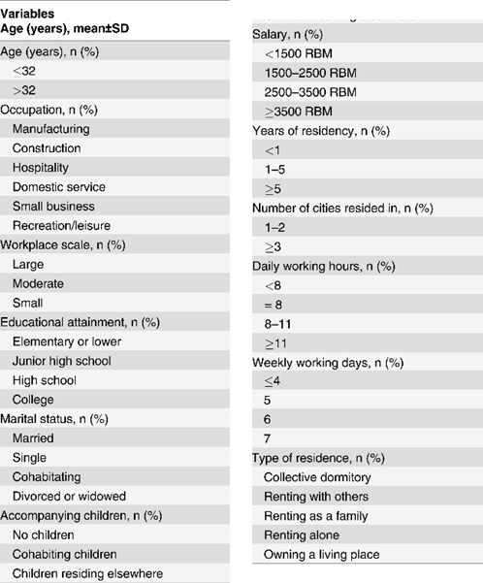
Data Collection and Preparation
Background
Sampling Method
Data Preparation
Statistical Method
Results
Evaluation
1. Socio-demographic Characteristics
Age
Occupation
Workplace Scale
Educational Attainment
Marital Status
Accompanying Children
Salary
Years of Residency
Number of Cities Resided
Daily Working Hours
Weekly Working Days
Type of Residence

Slide 7
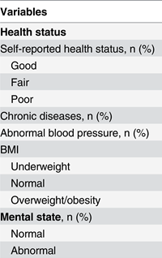
Data Collection and Preparation
Background
Sampling Method
Data Preparation
Statistical Method
Results
Evaluation
2. Physical Health
Self-reported Health Status
Chronic Diseases
Abnormal Blood Pressure
BMI
3. Mental Health
Symptom Checklist-90-Revised
<= 160 normal
>160 abnormal

Slide 8
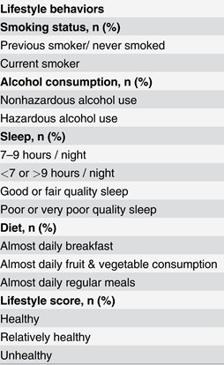
Data Collection and Preparation
Background
Sampling Method
Data Preparation
Statistical Method
Results
Evaluation
4. Lifestyle Score (0-6)
Current Smoker (past 30 days)
Hazardous Alcohol Use (AUDIT-C)
Sleep Hours (<7 or >9) and Sleep Quality (Poor)
Frequency of Breakfast (Not Almost Daily)
Frequency of Fruits and Vegetables (Not Almost Daily)
Regular Meal (Not Almost Daily)
1 Score allocated for every Criterion fulfilled
Healthy (0 score)
Relatively Healthy (1-2 scores)
Unhealthy (3-6 scores)
Notes:
Alcohol Use Disorders Identification Test-Consumption questionnaire

Slide 9
Statistical Methods
Background
Sampling Method
Data Preparation
Statistical Method
Results
Evaluation
Un-paired T Test
Null Hypothesis: gender and socio-demographic characteristics / health status are independent.
Level of significance: P-value <0.05
Socio-demographic characteristics
Health status
Association between lifestyle score and socio-demographics characteristics and physical and mental status
Chi-Square test
Dependent Variable – Lifestyle Score
Nominal
Healthy, Relatively Healthy, Unhealthy
Logistic Regression

Slide 10
Socio-demographic Characteristics of Participants
Background
Sampling Method
Data Preparation
Statistical Method
Results
Evaluation
51.3%
48.7%
5484
Notes:
On average, the male migrants are older than female migrants.
A higher proportion of male migrants had completed high school or college and earned over RMB 2500 per month.

Slide 11
Socio-demographic Characteristics of Participants
Background
Sampling Method
Data Preparation
Statistical Method
Results
Evaluation
51.3%
48.7%
48.2%
51.8%
New Generation Migrant Workers

Slide 12

Socio-demographic Characteristics of Participants
Background
Sampling Method
Data Preparation
Statistical Method
Results
Evaluation
51.3%
48.7%
48.2%
51.8%
50.9%
24.1%
Attended Junior High School
Attended
High School

Slide 13
Socio-demographic Characteristics of Participants
Background
Sampling Method
Data Preparation
Statistical Method
Results
Evaluation
Had Children
70%
Married
73.3%
Earned RMB 1500-3500
77.1%
More than 5 days a week
68.7%
More than 8 hours per day
51.5%
28.4%
Lived in collective dormitories

Slide 14
Health Status of Migrant Population
Background
Sampling Method
Data Preparation
Statistical Method
Results
Evaluation

Slide 15
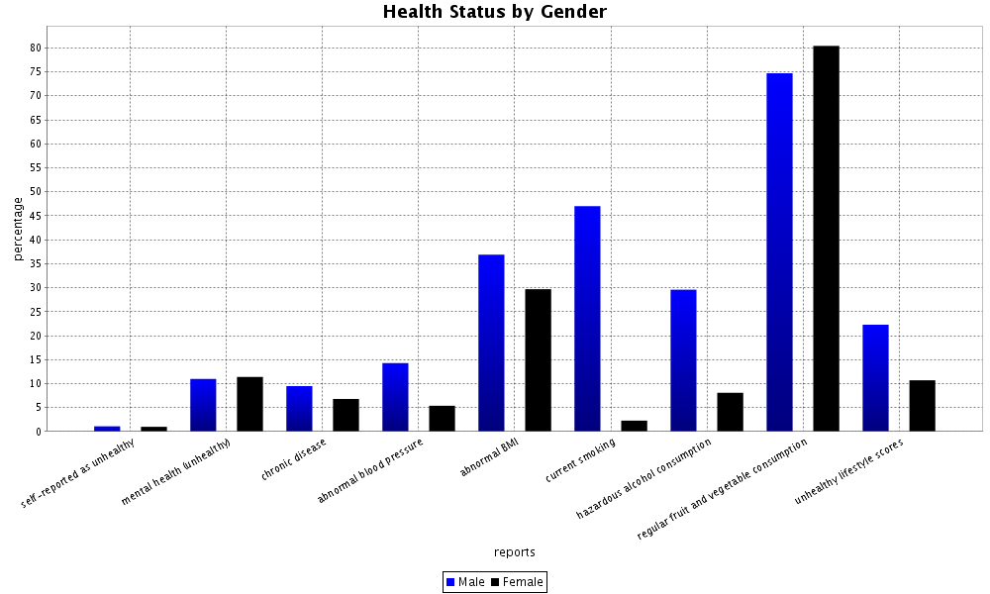
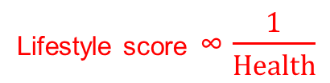
Background
Sampling Method
Data Preparation
Statistical Method
Results
Evaluation
Health Status of Migrant Population
Lifestyle score ∞ $\frac{1}{Health}$

Slide 16
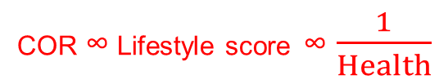
Background
Sampling Method
Data Preparation
Statistical Method
Results
Evaluation
Association between Lifestyle Score and Socio-demographic Characteristics and Physical and Mental Status
COR ∞ Lifestyle score ∞ $\frac{1}{Health}$
 | Male |  |  | Female
 | COR | 95% CI | P | COR | 95% CI | P
Occupation
Manufacturing | 1.0 |  |  | 1.0
Construction | 1.216 | 0.992-1.489 | 0.059 | 1.043 | 0.669-1.627 | 0.853
Hospitality | 1.806 | 1.275-2.559 | <0.001 | 1.675 | 1.263-2.222 | <0.001
Domestic Service | 0.849 | 0.604-1.193 | 0.344 | 1.657 | 1.314-2.090 | <0.001
Small Business | 1.183 | 0.891-1.570 | 0.244 | 1.556 | 1.222-1.981 | <0.001
Recreation/leisure | 3.248 | 2.379-4.435 | <0.001 | 5.563 | 4.268-7.250 | <0.001

Slide 17
Association between Lifestyle Score and Socio-demographic Characteristics and Physical and Mental Status
Background
Sampling Method
Data Preparation
Statistical Method
Results
Evaluation
 | Male
 | COR | 95% CI | P
Workplace Scale
Large | 1.0
Moderate | 0.965 | 0.802-1.161 | 0.702
Small | 1.422 | 1.154-1.752 | <0.001

Slide 18
Background
Sampling Method
Data Preparation
Statistical Method
Results
Evaluation
Association between Lifestyle Score and Socio-demographic Characteristics and Physical and Mental Status
 | Male |  |  | Female
 | Cor | 95% CI | P | Cor | 95% CI | P
Hours worked per day
< 8 | 0.952 | 0.384-2.359 | 0.915 | 1.296 | 0.781-2.151 | 0.316
= 8 | 1.0 |  |  | 1.0
9-10 | 1.074 | 0.907-1.273 | 0.406 | 1.426 | 1.172-1.734 | <0.001
>= 11 | 1.533 | 1.238-1.898 | <0.001 | 1.287 | 1.055-1.569 | 0.013

Slide 19
Background
Sampling Method
Data Preparation
Statistical Method
Results
Evaluation
Association between Lifestyle Score and Socio-demographic Characteristics and Physical and Mental Status
 | Female
 | COR | 95% CI | P
Marital status
Married | 1.0
Single | 2.023 | 1.664-2.461 | <0.001
Cohabitating | 1.564 | 0.873-2.803 | 0.133
Divorced or widowed | 1.533 | 0.621-3.784 | 0.355
Salary
< 1500 RMB | 1.0
1500 – 2500 RMB | 0.817 | 0.638-1.046 | 0.109
2500 – 3500 RMB | 0.822 | 0.622-1.085 | 0.166
>= 3500 RMB | 1.618 | 1.137-2.303 | 0.008

Slide 20
Background
Sampling Method
Data Preparation
Statistical Method
Results
Evaluation
Association between Lifestyle Score and Socio-demographic Characteristics and Physical and Mental Status
 | Male |  |  | Female
 | Cor | 95% CI | P | Cor | 95% CI | P
Number of cities experienced
1 – 2 |  |  |  | 1.0
>= 3 |  |  |  | 1.311 | 1.072-1.602 | 0.008
Mental Status
Normal | 1.0 |  |  | 1.0
Abnormal | 3.105 | 2.454-3.930 | <0.001 | 2.566 | 2.024-3.252 | <0.001

Slide 21
Recommendations
Background
Sampling Method
Data Preparation
Statistical Method
Results
Evaluation
Urgent need to promote healthy lifestyle behaviors
Limited healthcare facilities,
social network and education
`
Tailored interventions on specific sub-groups
Recreation/ leisure sector
Single women
`
Notes:
This group has limited experience with local healthcare facilities, a limited social network and limited education
The aggregation of personal data with health data
is arguably more intrusive, and as surveillance of individuals becomes part
of the big data health picture, it raises further questions about whether
data and predictions could be used outside the health- care domain to
discriminate against individuals in areas such as employ- ment, insurance,
and education.
Health interventions integrated with the migrant workers’ favorable union of the same origin

Slide 22
Contributions
Background
Sampling Method
Data Preparation
Statistical Method
Results
Evaluation
Provide foundation for future studies
D
Help direct healthcare resources more effectively
C
Identify relationships between health conditions and lifestyle behaviors
B
A
Study migrant workers: traditionally neglected

Slide 23
Limitations
Background
Sampling Method
Data Preparation
Statistical Method
Results
Evaluation
1
Lifestyle data was not collected from non-migrant residents
2
Information bias due to self-reported lifestyle information
3
Cross-sectional study in nature: only association evaluated
Notes:
1) Lifestyle data was not collected from non-migrant Shanghaiese residents → cannot direct compare
2) Self-reported lifestyle information and physician-diagnosed chronic diseases may have resulted in some misclassifications and information bias
3) Study is cross-sectional → only association, not causation can be evaluated (longitudinal studies needed to elucidate cause-effect relationships)

Slide 24

Thank you.
Questions?

Slide 25
Sampling Method - stratified multistage cluster random sampling
District - 7 out of 16 district
1 community health service center randomly selected for 1 district
Occupation
1) manufacturing, 2) construction, 3) hospitality,
4) domestic service, 5) small business 6) recreation/leisure
Workplace
- more than 50% of employees were migrants
1) large, > 500 employees
2) moderate, 100–500 employees
3) small, < 100 employees

Slide 26
Socio-demographic Characteristics
Age
Occupation
Workplace Scale
Educational Attainment
Marital Status
Accompanying Children
Salary
Years of Residency
Number of Cities Resided
Daily Working Hours
Weekly Working Days
Type of Residence

Slide 27
Physical and Mental Health Status
BMI - (kg/m^2)
<18.5 underweight
18.5 - 24 normal
>24 overweight
Mental State - Symptom Checklist-90-Revised
<= 160 normal
>160 abnormal
Notes:
BMI was calculated from self-reported height and weight according to the Chinese criteria
[34], a BMI<18.5 indicating underweight, a BMI between 18.5 and 24 normal weight, and a
BMI 24 overweight or obesity. A history of one or more of the following chronic diseases was
recorded: hypertension, ischemic heart disease, diabetes, chronic obstructive pulmonary disease,
asthma, renal dysfunction, abnormal liver function, rheumatoid arthritis, osteoarthritis,
or mental illness.
To assess mental health we employed a Chinese version of the Symptom Checklist-90-Revised
(SCL-90-R)[30], a self-reported mental health questionnaire. An SCL-90 score 160 indicates
normal mental health, and a SCL-90 score >160 abnormal mental health [31]. These thresholds
are widely used in Chinese research

Slide 28
Lifestyle Behaviours
Smoking Status
Alcohol Consumption
Duration and Quality of Sleep
Diet Habits
Physical Activities

Slide 29
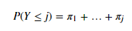
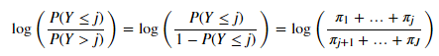
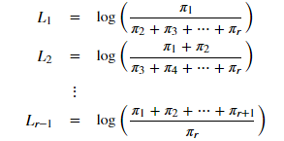
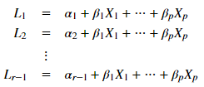
The Proportional-Odds Cumulative Logit Model
For Ordinal data: lifestyle score
The associated probabilities:
A cumulative logit is defined as:
The sequence of cumulative logits may be defined as:
Logistic Regression:

